Slide 1
VIRTUAL POLICE STATION
The Police Station, but it’s everywhere for you!

Slide 2
The Problem Statement!
Developing a Virtual Police Station to receive FIR with OCR based digital signature authenticated through
digital signature (Aadhar Number based authentication).
So how did we come across this solution? We build this solution because we had encountered a problem on our own! So we the solution we came across was -

Slide 3
So why was this a problem?
We wanted to think of a very independent and accessible government service that can able citizens to file FIRs with ease and WITHOUT having to worry about external pressures and problems that hindered them in between the processes of getting their complaints filed to the respective authorities. The victims were not able to file FIRs through traditional methods because of the police station being either corrupt or themselves being involved with defaulters of the law.

Slide 4
THE SOLUTION!

Slide 5
THE VIRTUAL POLICE STATION!
How does this work?
Our service provides you with remote FIR registration
We verify if your FIR is authentic or not by your digital signature and OCR Verification
Your FIR is reported to another remote police station with an E-Cell that verifies your FIR.

Slide 6
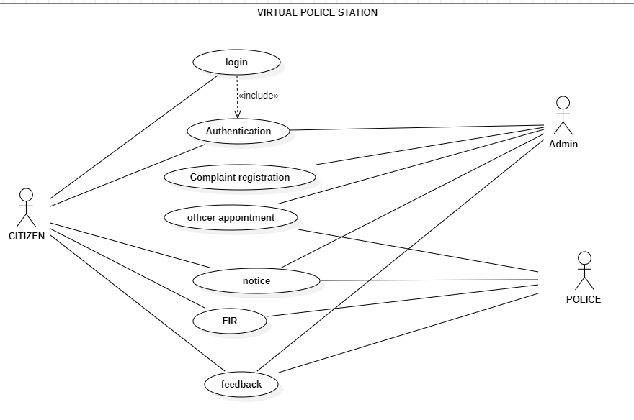
HOW IT WORKS!
0
02
RANKS & POSITIONS
UNIFORMS
03
0
OFFICERS
THE POLICE IN USA
You can describe the topic of the section here
You can describe the topic of the section here
You can describe the topic of the section here
You can describe the topic of the section here

Slide 7
THANK YOU

